Slide 1
Project ECO
Ivan Giacomoni – Daniele Bufalieri

Slide 2





Welcome on ECO!
Eco is a tool dedicated to safeguarding
of the environment in Italian municipalities and provinces,
in our case Rome.
Our goal is to provide you with a useful platform
for police or forestry to monitor the
environmental health of our cities.
We analyze real-time data regarding
Chemical Agents, Weather and UV Rays.
We manage operator advertisements
to alert citizens of any problems
We provide study support tools
of the phenomenon for sector analysts.

Slide 3
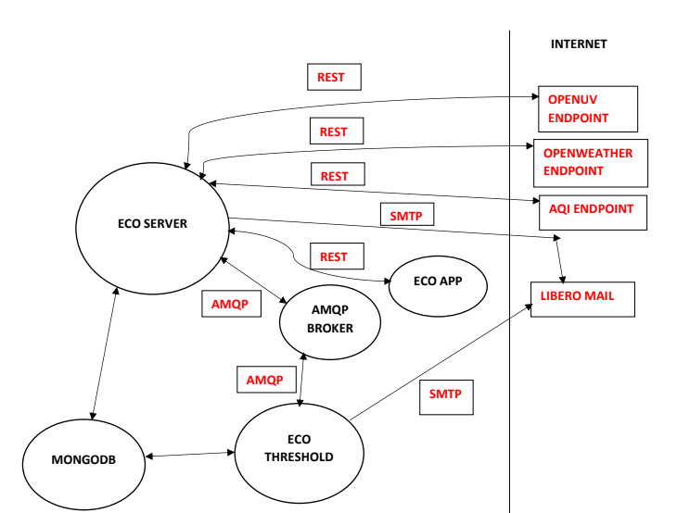
System Design
There are three types of user in the system: Citizen, Operator and Superuser. Citizens can register by filling in a form, they have access to the Dashboard in which they can view real-time data from Chemical Agents, Weather Forecasts and UV Rays. The operator must be registered by the Admin and has access and he can add Announcements to alert citizen about problems .

Slide 4
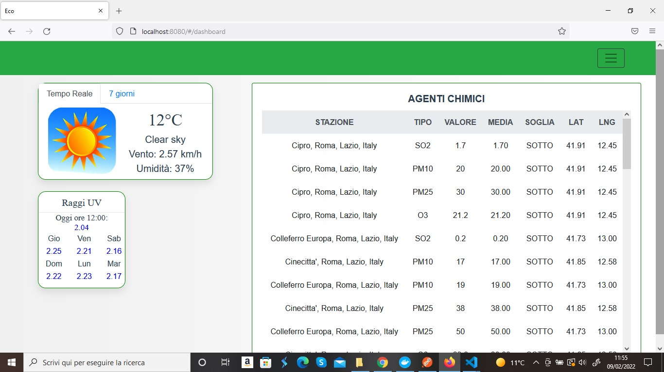
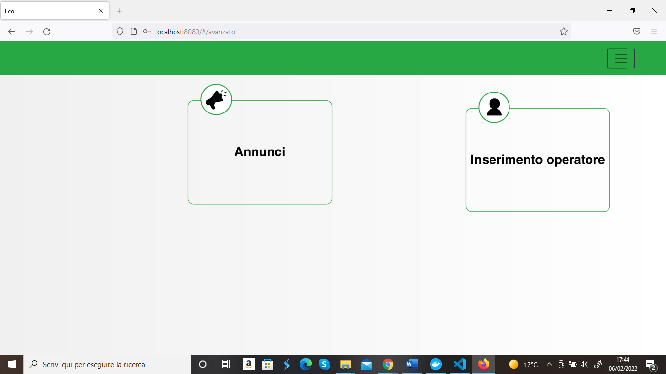
DASHBOARD
ADVANCED MENU

Slide 5
Chemical Agents
The data of the chemical agents, obtained through the API of an external service:
They are accessible to Users from the Dashboard via an intuitive table, it is possible to see the average for each kind of chemical agent and station
Furthermore, there is a threshold to alert users if the current value is higher than the historical average

Slide 6
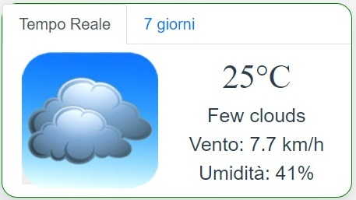
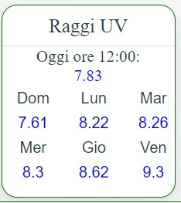
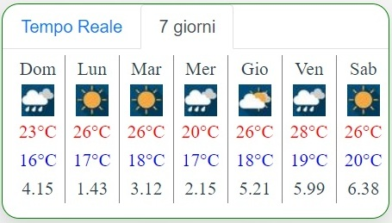
Meteos and UV rays
Weather and UV rays are visible in the Dashboard by the Citizens.
For operators they are useful tools to study the correlation with O3 Agents.

Slide 7
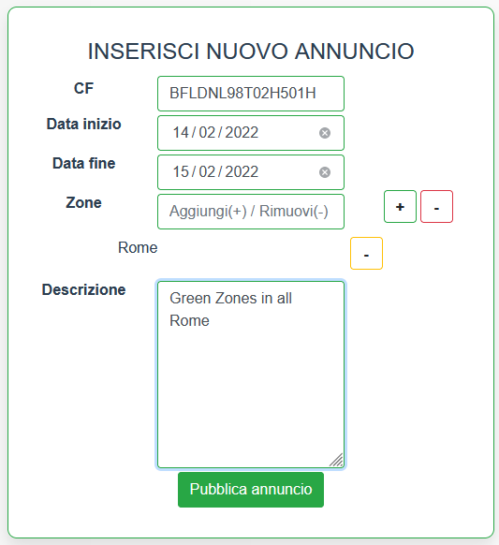
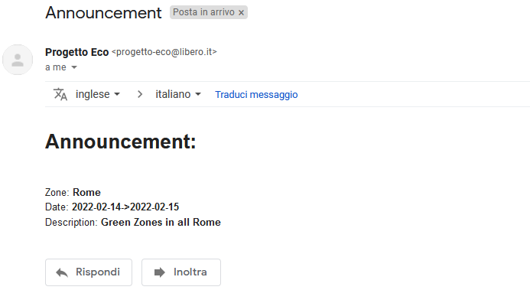
Announcements
Announcements are sent by operators in the Advanced menu to notify citizens of a well-known event, such as green zones to reduce vehicle traffic. At the time of publication of the announcement, each subscriber to the platform will receive an email with the information indicated by the operators.

Slide 8
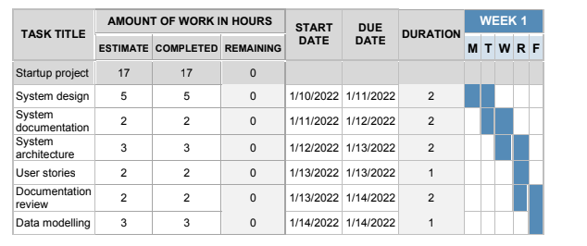
Scrum development
Each sprint is of the duration of one week. The estimated number of days to complete the
project is 25. So, in order to complete the project, 5 sprints were needed.
Sprint 1

Slide 9
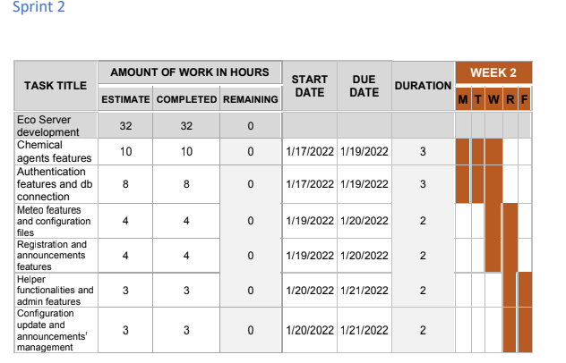
Sprint 2

Slide 10
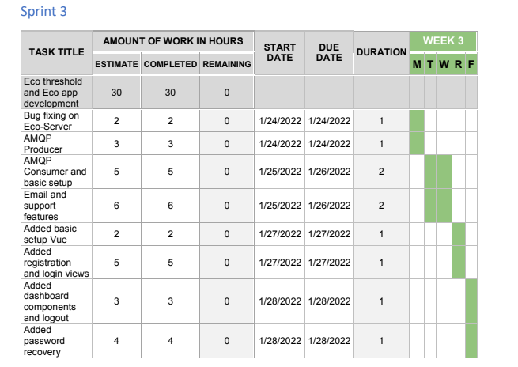
Sprint 3

Slide 11
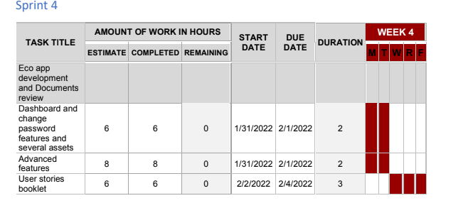
Sprint 4

Slide 12
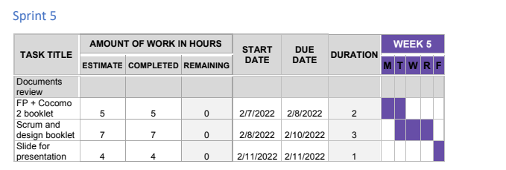
Sprint 5

Slide 13
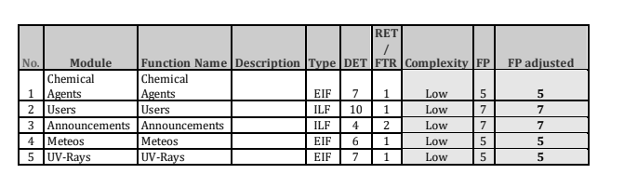
Function Points
For the function points estimation considers that we have used several external web services:
AQI service, for getting chemical agents data from some stations in the province of Rome
OpenWeather service, for getting informations about the weather in the province of Rome
OpenUV service, for getting informations about the UV rays in the province of Rome
Data functionalities

Slide 14
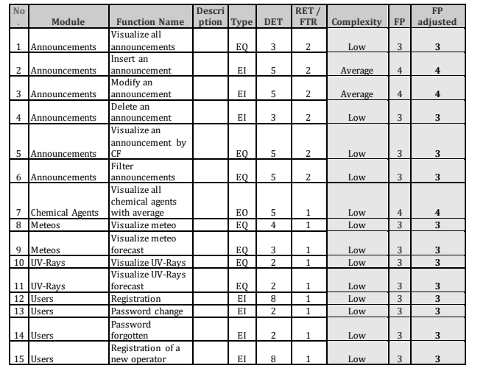
Transactions

Slide 15
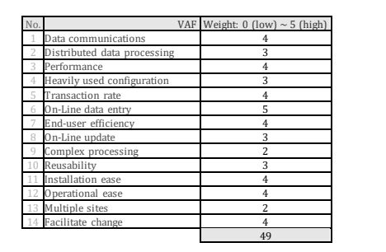
Adjusted FP parameters
The value for the unadjusted function points is 77.
The value for the adjusted function points is 87.78.

Slide 16
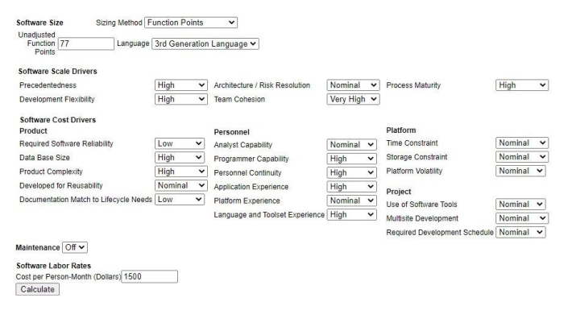
Setup of Cocomo II

Slide 17
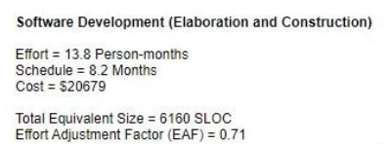
Results of Cocomo II
Above we have our results by the Cocomo analysis, and if we look at the total
equivalent size (in LOC) we have a value 6160 LOC. By looking at the real number of LOC
of our project, we have the following:
• Eco server: about 2101 LOC
• Eco threshold: about 391 LOC
• Eco app: about 5345 LOC
We have a total amount of LOC of about 7837 LOC.

Slide 18
ECO
Thanks for your attention

